Slide 1
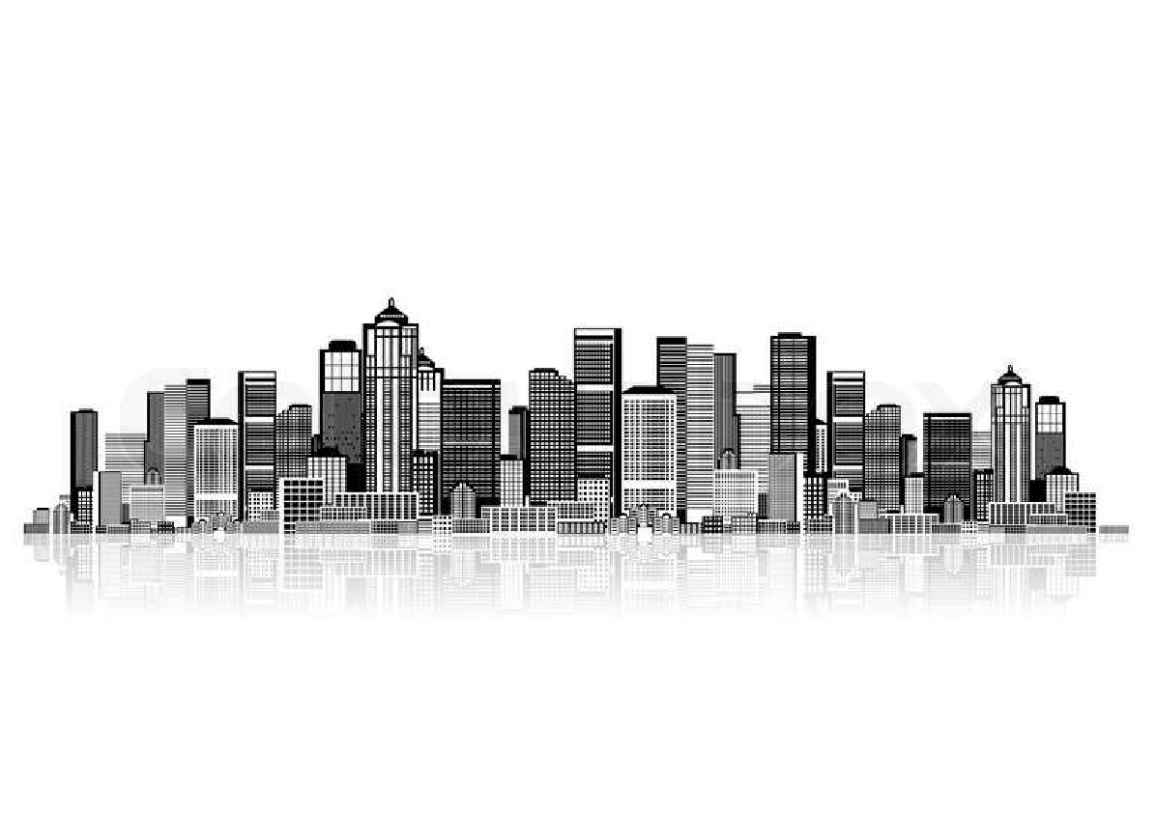
LECTURE # 02
ELEMENTS OF URBAN DESIGN

Slide 2
ELEMENTS OF URBAN DESIGN
Urban design is the process of shaping the physical setting for life in cities, towns and villages. It involves the design and coordination of all the elements that makes up cities and towns including.
  Buildings
  Public Spaces
  Streets
  Transport
  Landscape

Slide 3
BUILDINGS
Buildings are the most pronounced elements of urban design - they shape and articulate space by forming the street walls of the city. Well designed buildings and groups of buildings work together to create a sense of place.

Slide 4
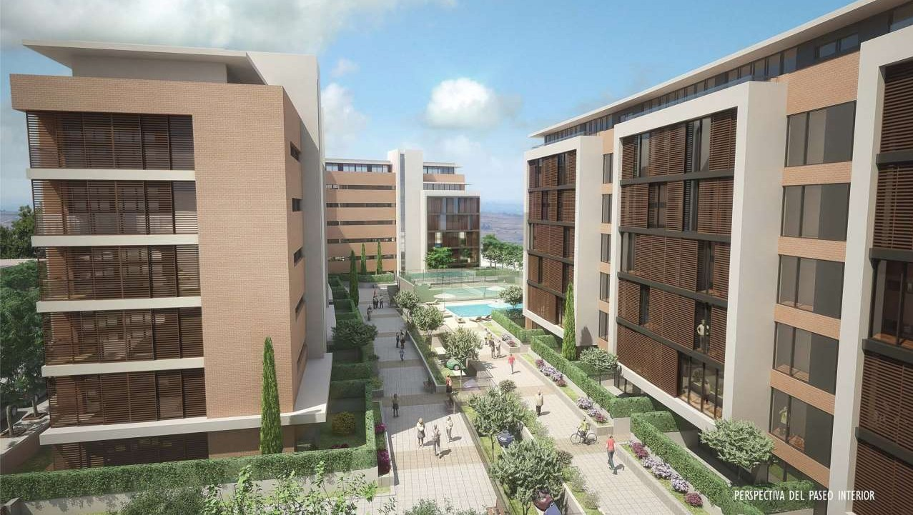
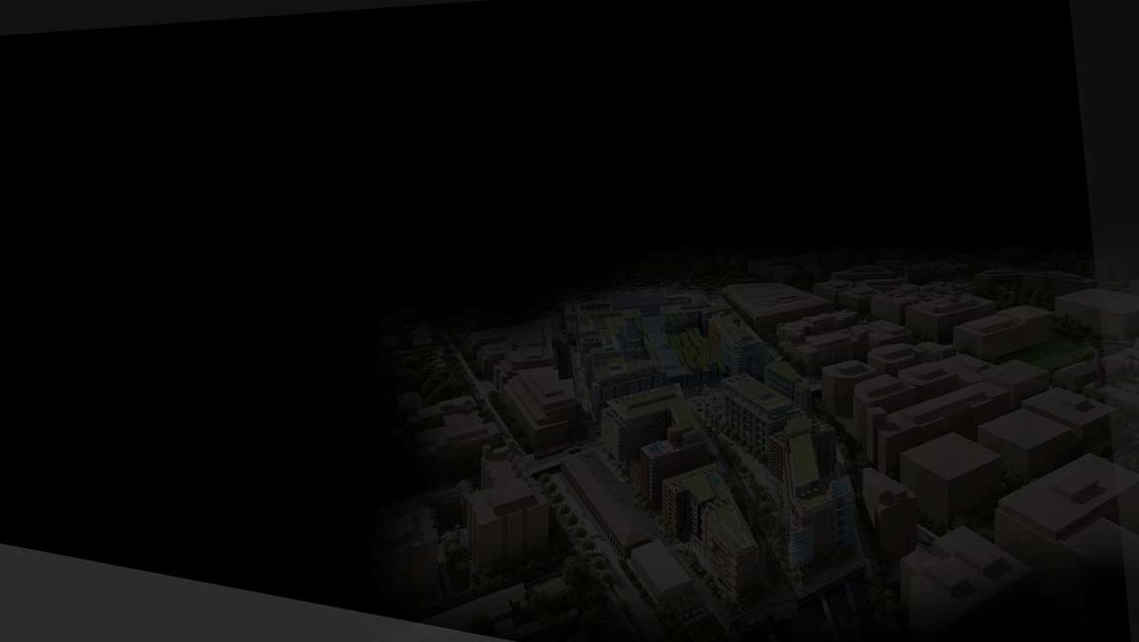
RESIDENTIAL Bldgs.
these are structures where people dwell.

Slide 5
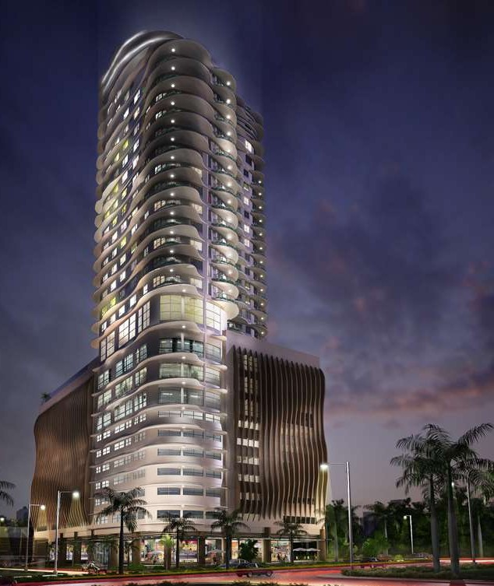
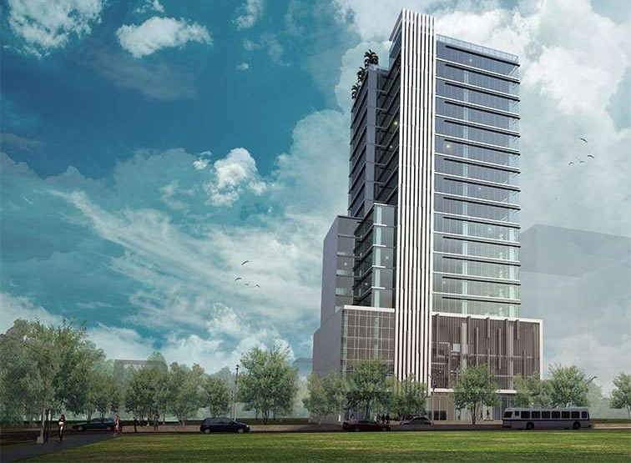
COMMMERCIAL BLDGS.
Asiatown IT Park, Cebu City
Calyx Centre (left) and RftDA Office Building (right)

Slide 6
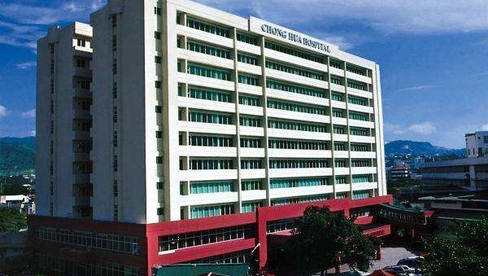
INSTITUTIONAL BLDG.
Chong Hua Hospital, Cebu City

Slide 7
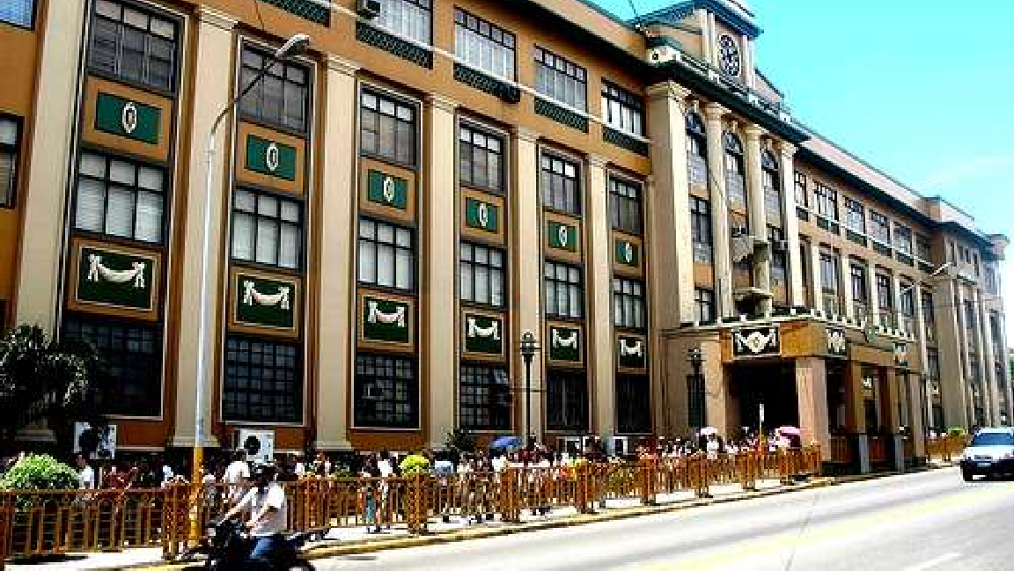
EDUCATIONAL BLDG.
University of San Carlos ftain Campus, Cebu City

Slide 8
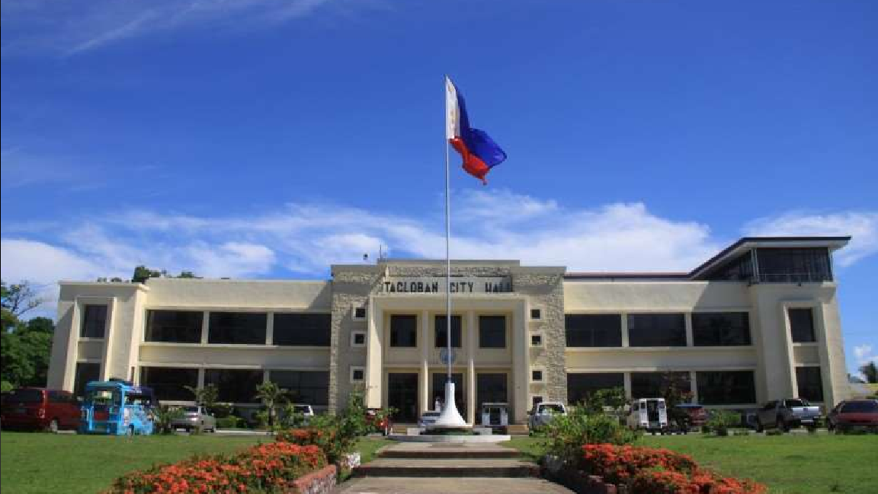
GOVERNMENT bldg.
One example is the Tacloban City Hall, the administrative building of the city.

Slide 9
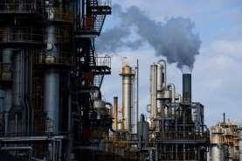
INDUSTRIAL BUILDING

Slide 10
PUBLIC SPACES
Great public spaces are the living room of the city - the place where people come together to enjoy the city and each other.
Public spaces make high quality life in the city possible - they form the stage and backdrop to the drama of life.
Public spaces range from grand central plazas and squares, to small, local neighborhood parks.

Slide 11
PUBLIC SPACES
Plaza – A plaza is an open urban public space, or gathering space such as a city square.
Green Areas – These are the protected areas of undeveloped landscape.
Play Grounds – A play grounds is an outdoor area provided for children to play on, especially at a school or public park.
Parks – A park is a large public green area in a town, used for recreation.
Square – A square is a plane figure with four equal straight sides and four right angles.

Slide 12
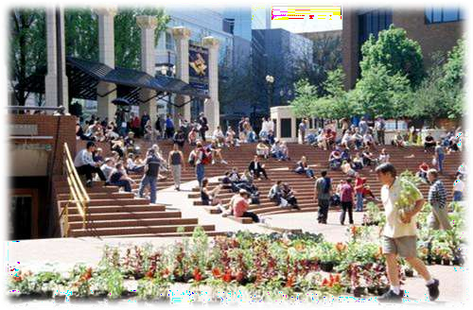
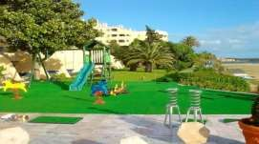
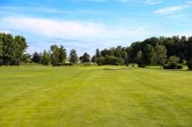
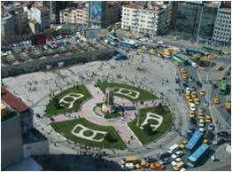

Slide 13
STREETS
Streets are the connections between spaces and places, as well as being spaces themselves.
They are defined by their physical dimension and character as well as the size, scale, and character of the buildings that line them.
Streets range from grand avenues to small, intimate pedestrian streets. The pattern of the street network is part of what defines a city and what makes each city unique.

Slide 14
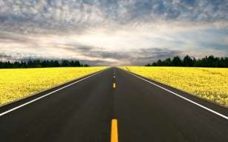
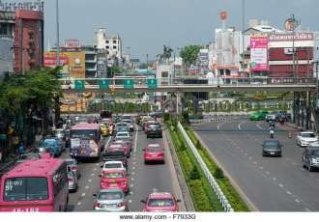
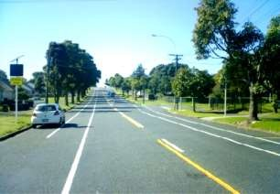
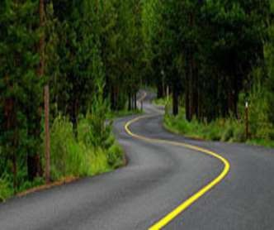
ROADS/STREETS
Highway – A main road, especially one connecting major towns or cities.
Collector/ Distributor – It is a low-to-moderate- capacity road which serves to move traffic from local streets to arterial roads.
Arterial – An arterial road or arterial thoroughfare is a high-capacity urban road.
Access/ Local – A local road that runs parallel to an expressway
and allows local
traffic to gain
access to property.

Slide 15
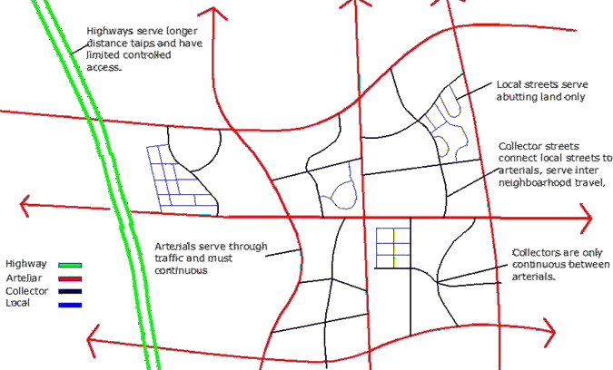

Slide 16
TRANSPORT
Transport systems connect the parts of cities and help shape them, and enable movement throughout the city.
They include road, rail, bicycle, and pedestrian networks, and together form the total movement system of a city.
The balance of these various transport systems is what helps define the quality and character of cities, and makes them either friendly or hostile to pedestrians.
The best cities are the ones that elevate the experience of the pedestrian while minimizing the dominance of the private automobile.

Slide 17
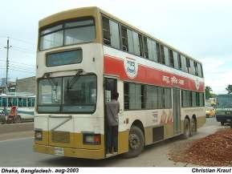
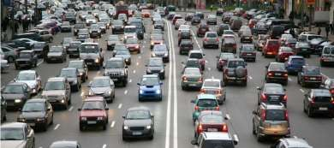
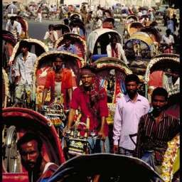
TRANSPORT
Public – A vehicle (typically a passenger vehicle) used to perform a public service or intended for use by the general public.
Motorized – A road vehicle powered by an internal combustion engine; an automobile.
Private – A passenger car assigned for private use.
Non-Motorized – It is the primary means of transportation (including bicycle, tricycle, etc) for people in many developing countries and is essential to consider in the design and modernization of transportation systems.

Slide 18
LANDSCAPE
The landscape is the green part of the city that weaves throughout - in the form of urban parks, street trees, plants, flowers, and water in many forms.
The landscape helps define the character and beauty of a city and creates soft, contrasting spaces and elements.
Green spaces in cities range from grand parks such as Lawrence Garden, Lahore to small intimate pocket parks.

Slide 19
